Slide 1

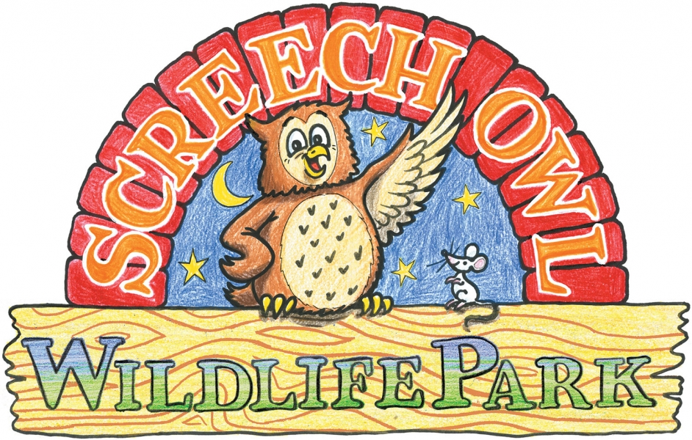
For My
I am Supporting
By Finlay Barrass

Slide 2

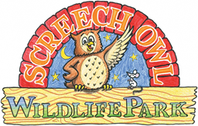

A bit about ‘Screech Owl Sanctuary’
Screech owl sanctuary is a fun wildlife park that helps and protects owls.
Its near Newquay, Cornwall
It was founded by a lady called Carolyn Screech.
They care for sick/injured and orphaned owls and fledgling owlets.
They rarely release their owls back into the wild for their own safety.
The sanctuary opened in 1990 and since has been home to hundreds of owls and other types of animals too.

Slide 3

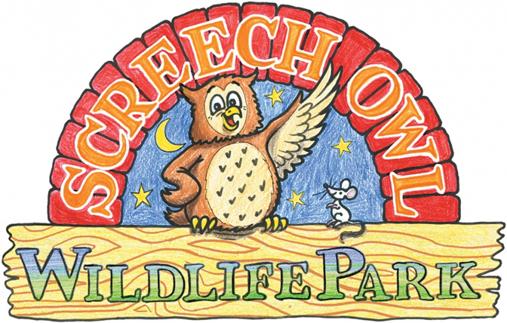
About their Owls
They got their first Tawny owl in 1992, it was sick and a baby which they named Dougal later realising she was female. She stayed there until 2012 when she died at the age of 20.
They have 5 different types of British owls, 6 types of European owls, 5 types of African owls, 7 American owl types, 1 from New Zealand, 1 from the west Indies and 6 types of Asian owls.
Pretty much every enclosure has two of the same owls in them for breeding purposes.

Slide 4
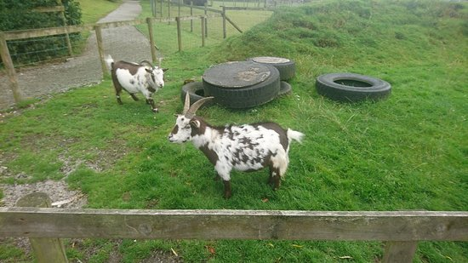
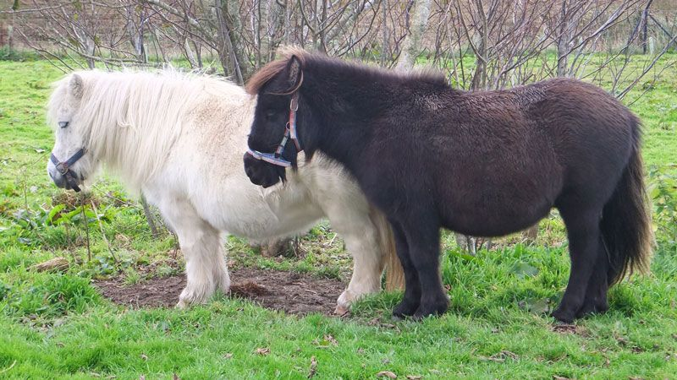
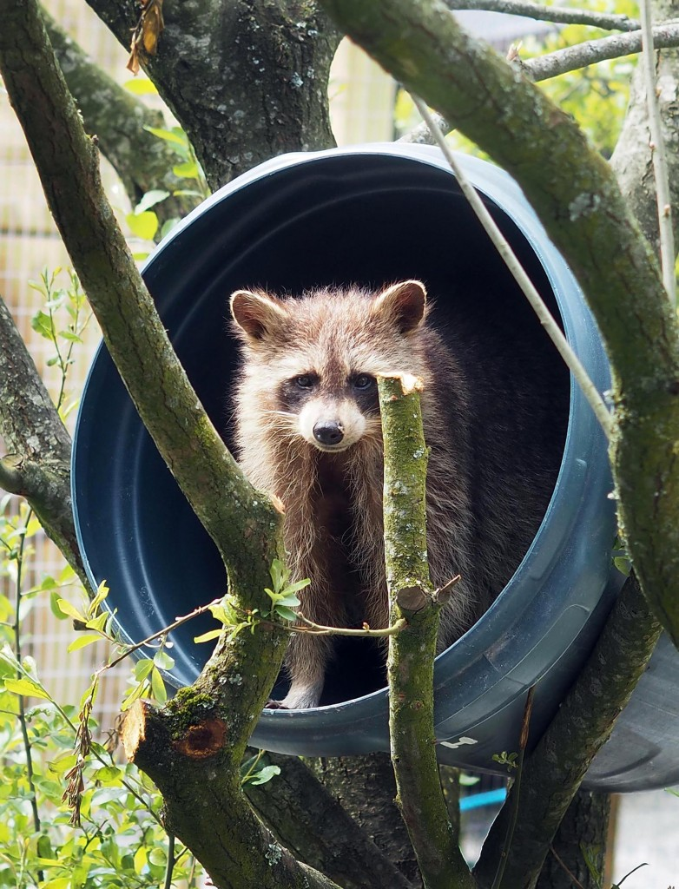
Other Animals they care for.
They don’t only protect owls they also have racoons, meerkats, alpacas, emus, pigmy goats and ponies.

Slide 5
Why I’ve chosen to sponsor The Owl Sanctuary and what I will do:
I’ve chosen the Owl Sanctuary because it’s one of my favourite places to visit when we go to Cornwall on Holiday.
The Coronavirus has meant they have had to close and furlough all of their staff, therefore with no visitors they’re not getting any income.
They desperately need money to: feed the animals every day, buy any medicine and pay the vet who uses the medicine and fix damaged enclosures.
To raise money I will do a sponsored run of a 6km which is the perimeter of the area that a Barn owl ,my personal favourite, flies from its nest in winter to feed herself and her young.

Slide 6
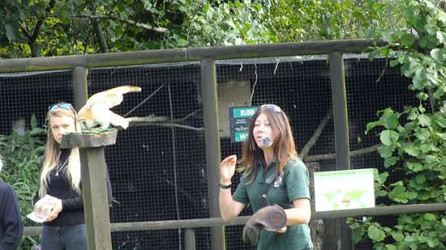
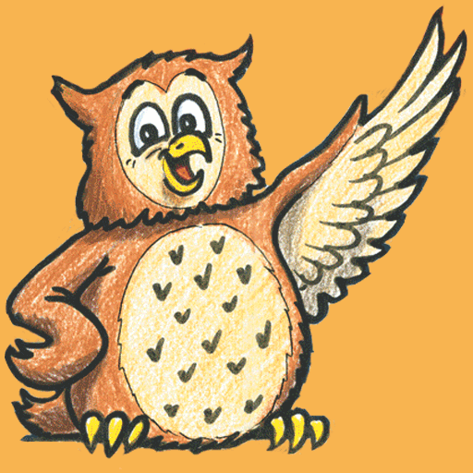
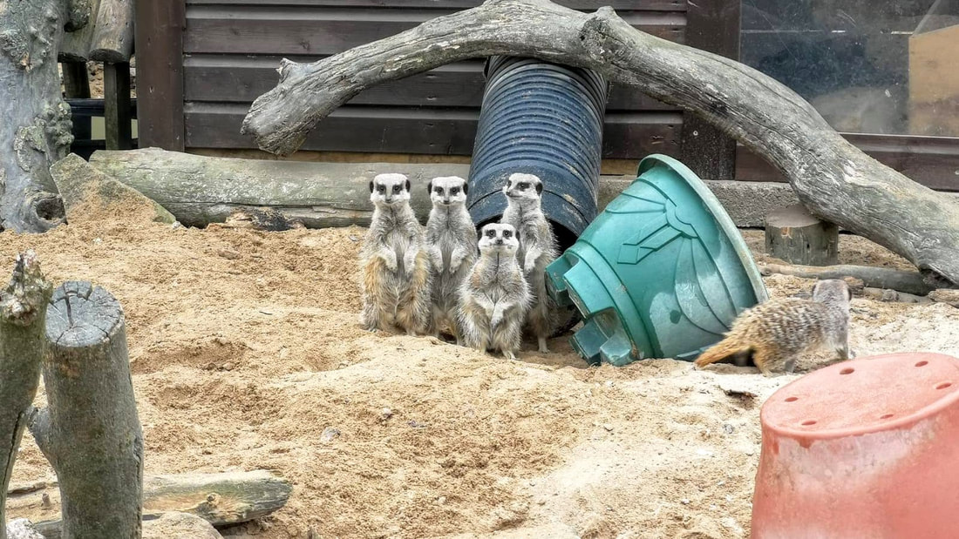
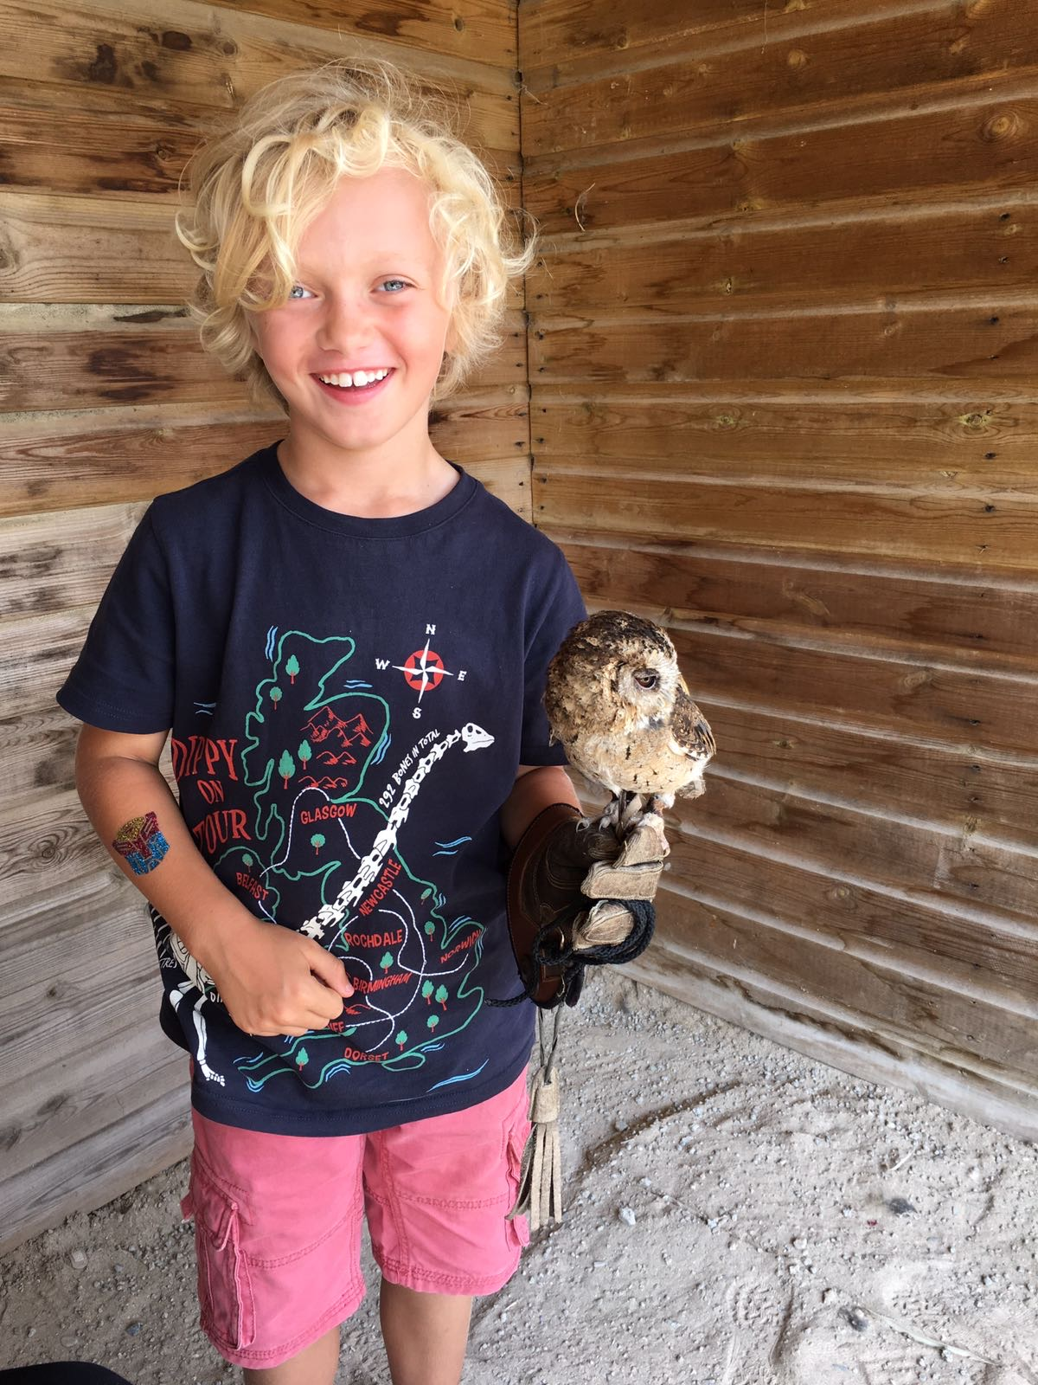
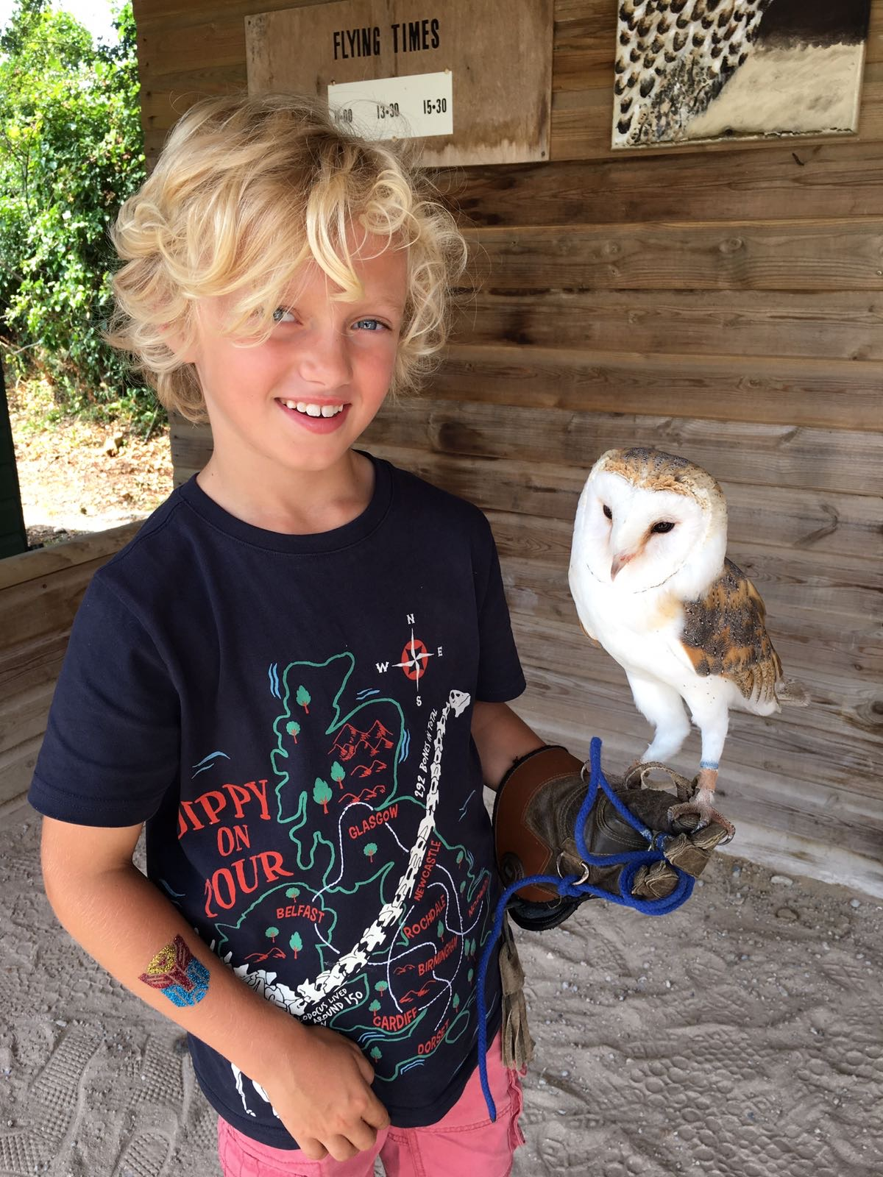
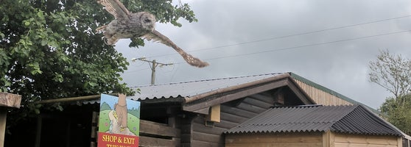
These are some pictures of Screech owl Sanctuary in action:

